Slide 1
BRUCELL0SIS
Hellen Nerima

Slide 2
Brucellosis is a highly contagious, zoonosis caused by ingestion of unpasteurized milk or undercooked meat from infected animals or close contacts with their secretions.
Caused by brucella bacteria.
It rarely spreads from person to person.
Brucellosis can also be called undulant fever, undulating fever, mediterranean fever, malt fever, rock fever.

Slide 3
Brucella
Gram -ve bacilli with variation in shape and seize- pleomorphic, short bacilli or cocco-bacilli
Nonmotile non-capsular, nonspore forming
Strict aerobes and grow very slowly (fastidious) on blood agar
Live as facultative intracellular pathogens

Slide 4
Physical properties
Susceptible to heat – rendered non viable within 10 minutes at 600c
Destroyed by heat methods of processing items – pasteurization
Sensitive to direct sunlight
Sensitive to acid – non viable in sour milk
Can remain viable after refrigeration for several weeks

Slide 5
Species
– 3 major species,
1. Brucella melitensis – affects sheep and goats, causes most cases of human disease, it is most virulent and invasive
2. brucella abortus – cattle
3. b. suis – swine
B. canis- dogs

Slide 6
Epidemiology
Mostly found around the Mediterenian sea.
Eastern Europe
Latin America
Asia
Africa
The Carribian

Slide 7
Transmission
– humans get exposed thro contact with infected animals or products of infected animals –
untreated milk, cheese, pork, meat or infected droplets
entry can be thro:
– mucous membranes
– broken skin
– ingestion – via untreated contaminated
Inhaled in infected aerosols

Slide 8
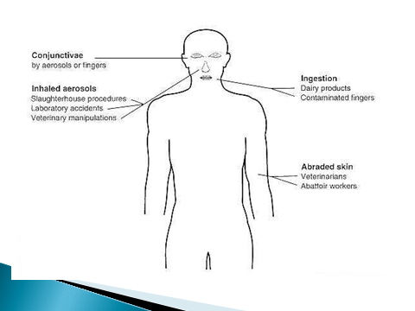

Slide 9
People it commonly affect
Those consuming unpasteurized milk
Occupation, people working in laboratories, handling animal products.
Veterinarians.
Slaughterhouse workers.

Slide 10
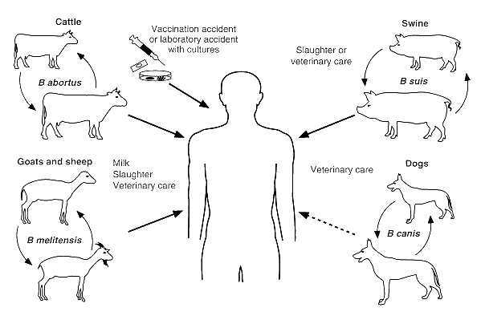

Slide 11
Virulence and pathogenesis
Complex, not fully understood.
The organism enters the host, followed by WBC phagocytosis, transported to different organs especially reticuloendithelial system.
It produced endotoxin Lipopolysaccharide, which play an important role of survival of bacteria inside monocytic cells, suppressing phagosome-lysosome fusion and internalizing bacteria in Endoplasmic reticulum.

Slide 12
Humoral immune response
On activation, B-cell produce IgM class antibodies, followed by IgG antibodies.
They promote clearance of extracellular bacteria and facilitate phagocytosis of the brucella.

Slide 13
Cell Mediated Immunity
TNF-alpha produced stimulates lymphocytes and macrophages to eliminate intracellular brucella. Virullent brucella suppresses TNF and IFN-gamma
Cytokines eg IL-12 promotes production of IFN-Y, which stimulates macrophage activation.
Cytokines IL-6, IL-4, IL-10 down regulates the protective response.

Slide 14
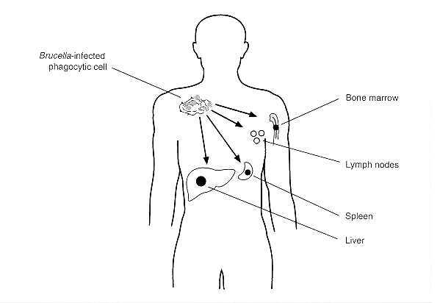
Spread of Brucella in the body

Slide 15
Clinical features
Incubation period 1-3 weeks.
Onset can be acute or gradual.
1. acute febrile illness with non specific symptoms;
Undulating fever (raising and falling) /relapsing fever, important in diagnosis.
Headache, sweating (often with foul moldy smell sometimes linked to wet hay) general body weakness
Anorexia and weight loss
Chills fatigue
Enlarged lymph nodes, liver and spleen are frequently found.
pancytopenia

Slide 16
Complication
Osteomyelitis, common complication.
Infection to CNS
Endocarditis, may be fetal in long run, mainly causes death.
Liver abscess.
In pregnant woman, miscarriage and birth defect in baby.
Chronic fatigue syndrome, (fatigue, fever, myalgia, joint pain)

Slide 17
Differencial Diagnosis
Malaria infection
Tuberculosis
Typhoid fever
Septic arthritis
Rheumatoid arthris
SLE
Gout
Osteoarthritis
HIV infection
Mumps

Slide 18
Lab diagnosis
Isolation of brucella species from samples. Specimen- Blood, infected tissue, CSF, urine, swabs from abscess, biopsy materials, bone marrow, liver aspirate.
Antibody titres to Brucella, titres at least 1:160 in convalescent phase (Recovery phase) serum sample is diagonistic.
slide aggultination test with brucella antiserum.
ELISA
Brucella skin test.

Slide 19
MANAGEMENT
Supportive management
Definitive management
Health education on prevention
Doxycyclin 100mg twice daily for 6wks together with
Rifampicin 600-900mg/day
Doxycyclin 100mg twice daily for 6wks together with,
Streptomycin 1g /day Intramascular for 2-3wks

Slide 20
Prevention
Health education to the society
Vaccination of animals, no vaccine for human
Testing herd before slaughter
Boiling milk before consumption
Changing traditional food habits, example eating raw meat, blood or bone marrow.
Observation of people who have been exposed for at least 6months.

Slide 21
THANK YOU

